Slide 1

Frontend JavaScript
Introduction to JavaScript Development
www.pragmatic.bg
Lector: Stiliyan Ivanov
Skype: stiliyan.iv.ivanov
E-mail: stiliyan.ivanov [at] pragmatic.bg
Facebook: https://www.facebook.com/stiliyan.iv.ivanov
LinkedIn: https://www.linkedin.com/pub/stiliyan-ivanov/33/2a0/bb5
Copyright © Pragmatic LLC 2013 – 2016

Slide 2

Table of contents
Dynamic HTML
How to Create DHTML?
HTML, CSS, JavaScript, DOM
Intro to JavaScript
JavaScript in Web Pages
JavaScript Syntax
Pop-up boxes
Debugging in JavaScript

Slide 3
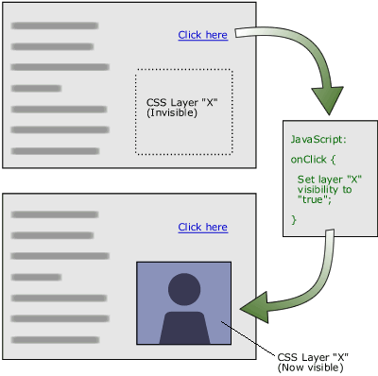
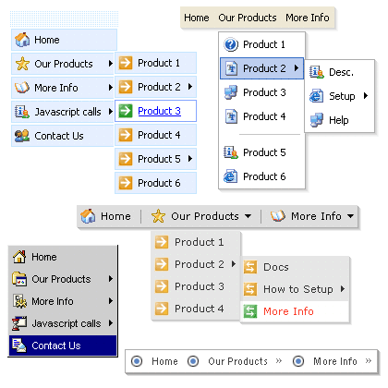
Dynamic HTML Dynamic Behavior at the Client Side

Slide 4
What is DHTML?
Dynamic HTML (DHTML)
Makes possible a Web page to react and change in response to the user’s actions
DHTML consists of HTML + CSS + JavaScript
DHTML
HTML
CSS
JavaScript
DOM

Slide 5
DTHML = HTML + CSS + JavaScript
HTML defines Web sites content through semantic tags (headings, paragraphs, lists, …)
CSS defines 'rules' or 'styles' for presenting every aspect of an HTML document
Font (family, size, color, weight, etc.)
Background (color, image, position, repeat)
Position and layout (of any object on the page)
JavaScript defines dynamic behavior
Programming logic for interaction with the user, to handle events, etc.

Slide 6

JavaScript Dynamic Behavior in a Web Page

Slide 7
JavaScript...
JavaScript is a front-end scripting language developed by Netscape for dynamic content
Lightweight and powerful
Can be used as object-oriented language
Embedded in your HTML page
Interpreted by the Web browser
Client-side, mobile and desktop technology
Simple and flexible
Powerful to manipulate the DOM

Slide 8
JavaScript Advantages
JavaScript allows interactivity such as:
Implementing form validation
React to user actions, e.g. handle keys
Changing an image on moving mouse over it
Sections of a page appearing and disappearing
Content loading and changing dynamically
Performing complex calculations
Custom HTML controls, e.g. scrollable table
Implementing AJAX functionality

Slide 9
What Can JavaScript Do?
Can handle events
Can read and write HTML elements and modify the DOM tree
Can validate form data
Can access / modify browser cookies
Can detect the user’s browser and OS
Can be used as object-oriented language
Can handle exceptions
Can perform asynchronous server calls (AJAX)

Slide 10
JavaScript Engines
Depends on Browser
V8 in Chrome, Chakra in IE, Spidermonkey in Firefox, JavaScriptCore for Safari, etc.
Services
Memory Management / GC
Just-in-Time Compilation
Type System
etc.

Slide 11
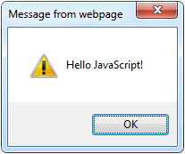
The First Script
<html>
<body>
<script type="text/javascript">
alert('Hello JavaScript!');
</script>
</body>
</html>

Slide 12
Using JavaScript Code
The JavaScript code can be placed in:
<script> tag in the head
<script> tag in the body - not recommended
External files, linked via <script> tag the head
Files usually have .js extension
Highly recommended
The .js files get cached by the browser
<script src="scripts.js" type="text/javscript">
<!– code placed here will not be executed! -->
</script>

Slide 13
JavaScript – When is Executed?
JavaScript code is executed during the page loading or when the browser fires an event
All statements are executed at page loading
Some statements just define functions that can be called later
No compile time checks
Function calls or code can be attached as "event handlers" via tag attributes
Executed when the event is fired by the browser
<img src="logo.gif" onclick="alert('clicked!')" />

Slide 14
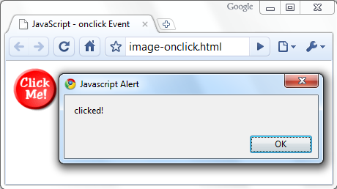
Calling a JavaScript Function from Event Handler – Example
<html>
<head>
<script type="text/javascript">
function test (message) {
alert(message);
}
</script>
</head>
<body>
<img src="logo.gif"
onclick="test('clicked!')" />
</body>
</html>

Slide 15
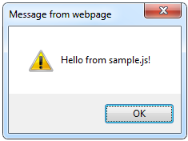
Using External Script Files
Using external script files:
External JavaScript file:
<html>
<head>
<script src="sample.js" type="text/javascript">
</script>
</head>
<body>
<button onclick="sample()" value="Call JavaScript
function from sample.js" />
</body>
</html>
function sample() {
alert('Hello from sample.js!')
}

Slide 16
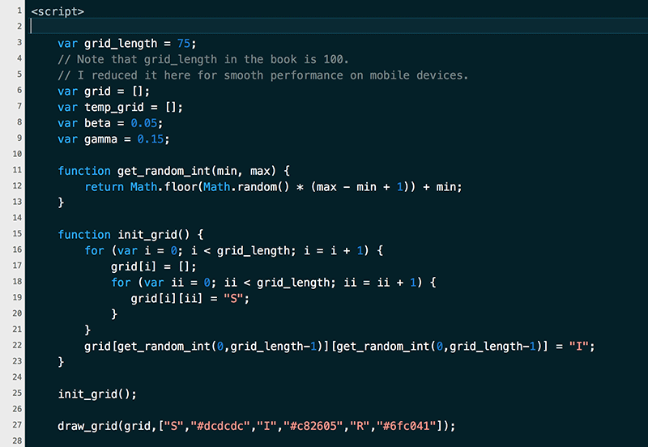
The JavaScript Syntax

Slide 17
JavaScript Syntax
The JavaScript syntax is similar to C
Operators (+, *, =, !=, &&, ++, …)
Variables (dynamically typed)
Conditional statements (if, else)
Loops (for, while)
Arrays (my_array[]) and associative arrays (my_array['abc'])
Functions (can return value)
Function variables

Slide 18
Standard Popup Boxes
Alert box with text and [OK] button
Just a message shown in a dialog box:
Confirmation box
Contains text, [OK] button and [Cancel] button:
Prompt box
Contains text, input field with default value:
alert("Some text here");
confirm("Are you sure?");
prompt ("enter amount", 10);

Slide 19


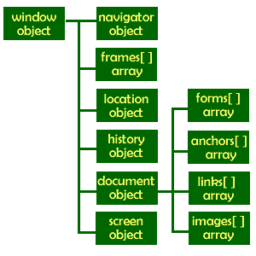
The Built-In Browser Objects

Slide 20
Built-in Browser Objects
The browser provides some read-only data via:
window
The top node of the DOM tree
Represents the browser's window
document
holds information the current loaded document
screen
Holds the user’s display properties
browser
Holds information about the browser

Slide 21
DOM Hierarchy – Example
window
navigator
screen
document
history
location
form
form
button
form

Slide 22

The Screen Object
The screen object contains information about the display
window.moveTo(0, 0);
x = screen.availWidth;
y = screen.availHeight;
window.resizeTo(x, y);

Slide 23
Document and Location
document object
Provides some built-in arrays of specific objects on the currently loaded Web page
document.location
Used to access the currently open URL or redirect the browser
document.links[0].href = "yahoo.com";
document.write(
"This is some <b>bold text</b>");
document.location = "http://www.yahoo.com/";

Slide 24
The Math Object
The Math object provides some mathematical functions
for (i=1; i<=20; i++) {
var x = Math.random();
x = 10 * x + 1;
x = Math.floor(x);
document.write(
"Random number (" +
i + ") in range " +
"1..10 --> " + x +
"<br/>");
}

Slide 25
The Date Object
The Date object provides date / calendar functions
var now = new Date();
var result = "It is now " + now;
document.getElementById("timeField")
.innerText = result;
...
<p id="timeField"></p>

Slide 26
Timers: setTimeout()
Make something happen (once) after a fixed delay
var timer = setTimeout('bang()', 5000);
5 seconds after this statement executes, this function is called
clearTimeout(timer);
Cancels the timer

Slide 27
Timers: setInterval()
Make something happen repeatedly at fixed intervals
var timer = setInterval('clock()', 1000);
This function is called continuously per 1 second.
clearInterval(timer);
Stop the timer.

Slide 28
Timer – Example
<script type="text/javascript">
function timerFunc() {
var now = new Date();
var hour = now.getHours();
var min = now.getMinutes();
var sec = now.getSeconds();
document.getElementById("clock").value =
"" + hour + ":" + min + ":" + sec;
}
setInterval('timerFunc()', 1000);
</script>
<input type="text" id="clock" />

Slide 29
Debugging JavaScript
Modern browsers have JavaScript console where errors in scripts are reported
Errors may differ across browsers
Several tools to debug JavaScript
Chrome developer tool
Firefox developer tool
Firebug for firefox
Opera developer tool

Slide 30
Firebug
Firebug – Firefox add-on for debugging JavaScript, CSS, HTML
Supports breakpoints, watches, JavaScript console editor
Very useful for CSS and HTML too
You can edit all the document real-time: CSS, HTML, etc
Shows how CSS rules apply to element
Shows Ajax requests and responses
Firebug is written mostly in JavaScript

Slide 31
JavaScript Console Object
The console object exists only if there is a debugging tool that supports it
Used to write log messages at runtime
Methods of the console object:
debug(message)
info(message)
log(message)
warn(message)
error(message)

Slide 32

Questions?

